Slide 1

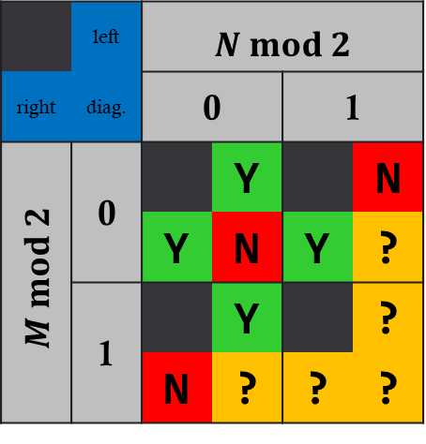




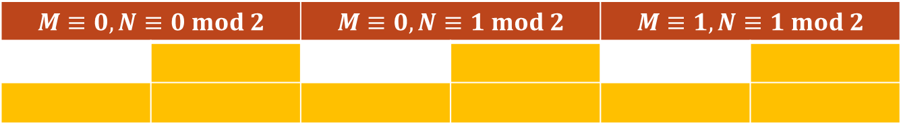






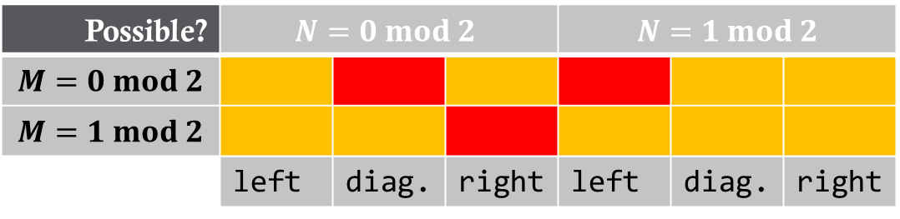










REFERNCE SLIDE
Possible? | $$N=0 mod 2$$ |  |  | $$N=1 mod 2$$
$$M=0 mod 2$$
$$M=1 mod 2$$
 | left | diag. | right | left | diag. | right
$$M≡0, N≡0 mod 2$$ |  | $$M≡0, N≡1 mod 2$$ |  | $$M≡1, N≡1 mod 2$$
even x even -> left not shown: odd x even -> left
even x odd -> diagonal not shown: odd x odd -> diagonal
Possible?
$M×2$ unit
$M×E$ unit ($E=0 mod 2$)
 | left | $$N mod 2$$
right | diag. | 0 |  | 1
$M mod 2$ | 0 |  | Y |  | N
 |  | Y | N | Y | ?
 | 1 |  | Y |  | ?
 |  | N | ? | ? | ?
$$2$$
$$N=2k, k∈ℕ^{+}$$
$$⋯$$
$$M$$
$$⋮$$
$$⋮$$
$$M−1$$
$$M$$
$$⋮$$
$$⋮$$
$$⋮$$
$$⋮$$
$$⋮$$
$$⋮$$
$$M=1$$
$$M=3$$
$$⋯$$
$$1$$
Examples:
$$M=2$$

Slide 2


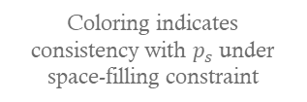

REFERNCE SLIDE
even x even -> left not shown: odd x even -> left
even x odd -> diagonal not shown: odd x odd -> diagonal
$$p_{s}$$
$$N mod 2$$
0
1
1
1
1
0
Coloring indicates consistency with $p_{s}$ under space-filling constraint
0
1
0
1
1
$$M mod 2$$
fill
left
1
1
0
0
1
right
diag.
0
1
0
0
cell layout

Slide 3








$$E$$
$$⋯$$
$$M$$
$$⋮$$
$$⋮$$
$$⋮$$
$$⋯$$
$E$+1

Slide 4
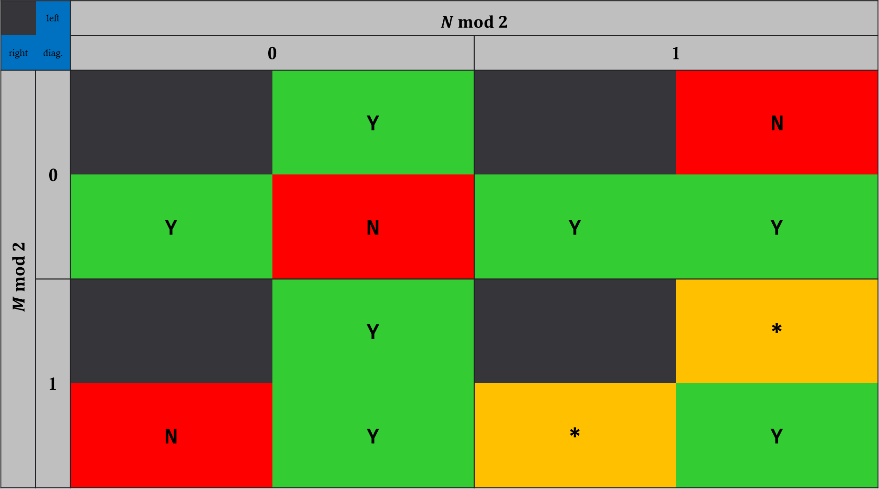
 | left | $$N mod 2$$
right | diag. | 0 |  | 1
$M mod 2$ | 0 |  | Y |  | N
 |  | Y | N | Y | Y
 | 1 |  | Y |  | *
 |  | N | Y | * | Y

Slide 5
Paths either don’t fully cover original region, or don’t arrive at original destination

Slide 6
% d: 1=left, 2=diag, 3=right
e = [2,4];
o = [1,3];
eo = {e,o};
m = repelem([0,1].',2,4);
n = repelem([0,1], 4,2);
d = repmat([nan,1;3,2],2,2);
isValidMatrix = zeros(4,4);
for k1 = 1:4
for k2 = 1:4
if isnan(d(k1,k2))
isValidMatrix(k1,k2) = nan;
continue
end
m_ = m(k1,k2);
n_ = n(k1,k2);
for M = eo{m_+1} % mod + 1 = index
for N = eo{n_+1} % mod + 1 = index
isValidMatrix(k1,k2) = isValidMatrix(k1,k2) + ...
isValid(M,N, d(k1,k2) );
end
end
end
end
isValidMatrix/2
function tf = isValid(M,N,d)
m = mod(M,2);
n = mod(N,2);
if d==1 && m==0 && n==1
tf = false;
elseif d==2 && m==0 && n==0
tf = false;
elseif d==3 && m==1 && n==0
tf = false;
elseif d~=2 && m==1 && n==1 && ( (M==1 && N~=1) || (M~=1 && N==1) )
tf = false;
else
tf = true;
end
end

